Slide 1
Testing and Software
Development Process
Software Testing

Slide 2
Review
How to test a web application?
What would you test?
Which kind of testing techniques can you apply?
What’s Configuration and compatibility testing ?

Slide 3
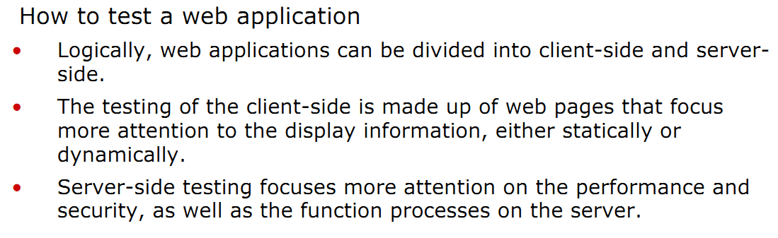

Slide 4
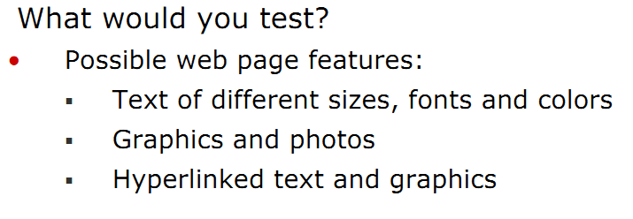
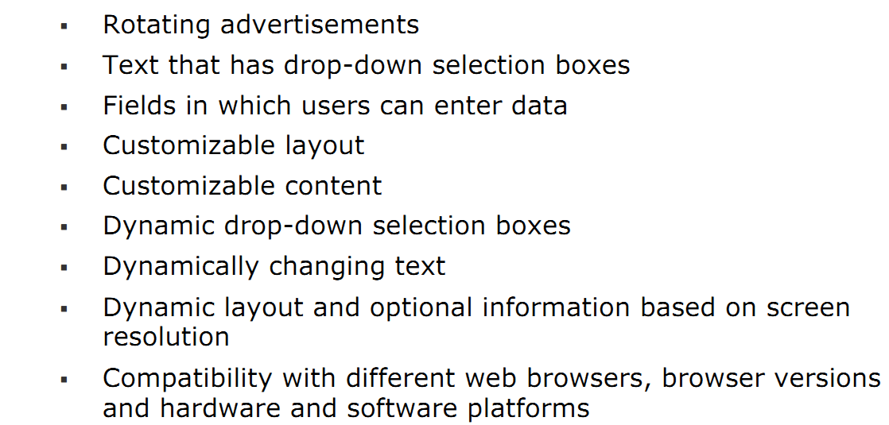

Slide 5
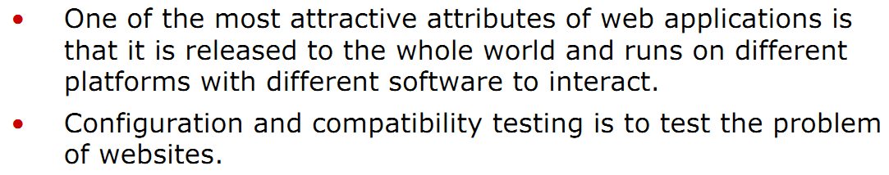

Slide 6
Objectives
Discuss testing issues in a software development process, including:
  Testing and software development process
  Test activity
  Test artifacts
  Some options for successful software testing

Slide 7
What Is Software Develop Process
Definition
  The process by which users’ needs are translated into a software product, often including:
  1. Requirement phase
  2. Design phase
  3. Implementation phase
  4. Testing phase
 Common software development models
  • Waterfall Model
  • V-Model
  • Spiral Model
  • Rational Unified Process

Slide 8
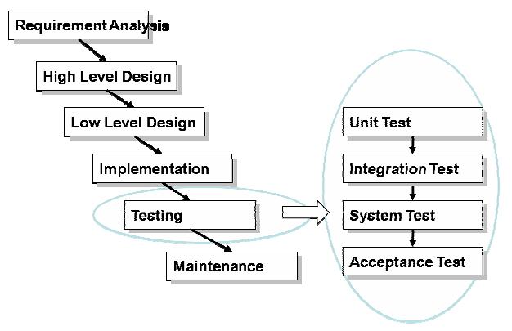
Waterfall Model

Slide 9
Testing And Waterfall Model
Testing and waterfall model
  The Waterfall model is the classic software development process model.
  The Waterfall model is suitable for a software project where the requirements are fairly stable.
  In the Waterfall model, testing is the last phase of the software development process. That is not always good.

Slide 10
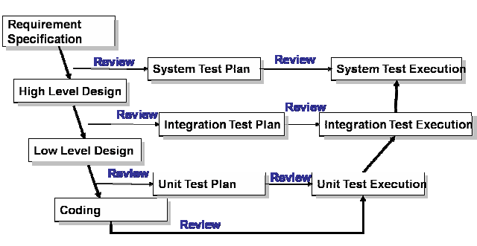
V-Model

Slide 11
Testing And V-Model
Testing and V-model
  In a waterfall model, testing is the last phase of the software develop process, where in a V-model, testing is an activity that goes through the whole software development process.
  Testers can be involved earlier.
    1. Testers can be familiar with the products. This is good for them to design qualified test cases.
    2. More defects will be found in the early phases. This will reduce the cost.
  The risk of finding serious defects near the end of the development process is reduced.
  V-model is the model that has been adopted by most organizations.

Slide 12
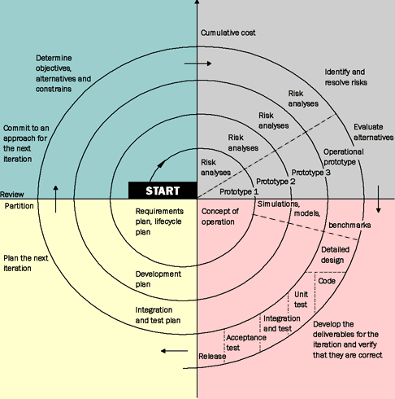
Spiral Model

Slide 13
Testing And Spiral Model
Spiral model
  A Spiral model is a risk-driven software development process.
  By applying a spiral model, you must first evaluate risks of the next phase before its beginning. As for testing, this can lead to more reasonable test processes because each item is arranged based on those evaluated risks.

Slide 14
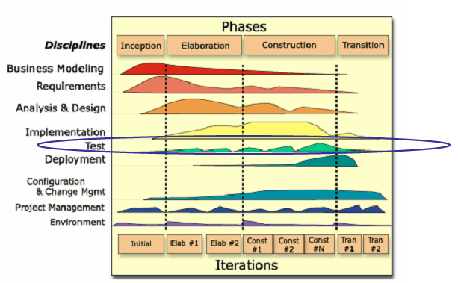
Rational Unified Process (RUP)

Slide 15
Testing And RUP
Rational Unified Process
  Rational Unified Process is a promising software engineering process nowadays.
    1. It is much more than an iterative process and provides a disciplined approach to assigning tasks and responsibilities within a development organization.
    2. Its goal is to ensure the production of high-quality software that meets the needs of its end users within a predictable schedule and budget.
  The preceding figure illustrates the overall architecture of the RUP, which has two dimensions:
    1. The horizontal axis represents time and shows the lifecycle aspects of the process as it unfolds.
    2. The vertical axis represents disciplines that logically group activities by nature.

Slide 16
Testing And RUP
Rational Unified Process
  The preceding graph also shows how the emphasis varies over time. For example, in early iterations you spend more time on requirements; in later iterations you spend more time on implementation.
  Continuously verifying Quality is one of the six best practices that RUP is designed to repeat. Testing is one of RUP’s disciplines that should be conducted throughout the entire lifecycle

Slide 17
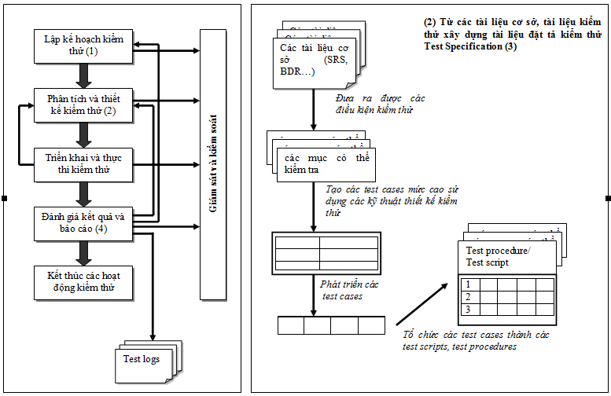
How Does a Software Tester Work

Slide 18
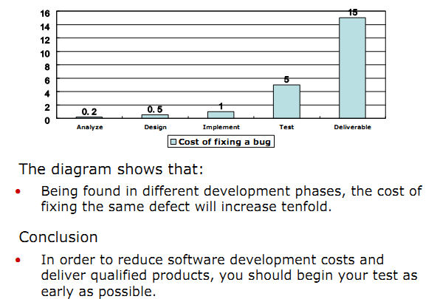
Cost of a Defect

Slide 19
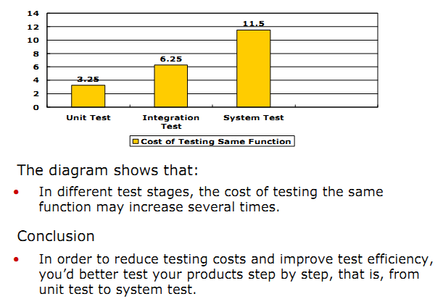
Cost of Testing Same Function

Slide 20
Test Activities
In general, the entire testing process during software development is divided into the following stages:
  Unit test: testing of individual software units or groups of related units. The units might be one or groups of procedures, menus, classes, etc.
  Integration test: testing in which software components are combined and tested to evaluate the interaction between them.
  System test: testing conducted on a complete, integrated system to evaluate the system’s compliance with its specified specification.
 In general, test activities include:
  Develop test plan (including design test cases)
  Build test environment
  Conduct test and report defects
  Regression unit test
  Develop unit test report

Slide 21
Test Artifacts
Testing artifacts is the work product of software testers, the most important categories of test documents include:
  Test Strategy
  Test Plan
  Test Design
  Test Case
  Test Procedure
  Test Report
  Defect Report
  Other Documents: test log, daily report, weekly report etc.

Slide 22
Test Strategy
Definition
  A document that describes the strategic plan on how the test effort will be conducted against one or more aspects of the target system.
ƒ Synopsis Example
  Introduction: Purpose, Scope, Intended Audience, Document Terminology and Acronyms, Reference
  Governing Evaluation Mission
  Test Approach: Measuring the Extent of Testing, Identifying and Justifying Tests, Conducting Tests (Technique 1 ..Technique n+1)
  Environment Needs
  Responsibilities, Staffing and Training Needs

Slide 23
Test Plan
Definition
  A document that describes the technical and management approach to be followed for testing a system or component. Typical content identifies the items to be tested, tasks to be performed, responsibilities, schedules and required resources for the testing activity.
ƒ Type of Test Plan
  According to different test phases of the whole test process, you may develop the following test plan:
  1. Unit Test Plan: Test plan used for unit test.
  2. Integration Test Plan: Test plan used for integration test.
  3. System Test Plan: Test plan used for system test.
  4. Acceptance Test Plan: Test plan used for acceptance test.

Slide 24
Test Plan Template
Contents (IEEE Std. 829-1998 )
  Introduction
  Test Items
  Software Risk Issues
  Features to Be Tested
  Features Not to Be Tested
  Approach
  Item Pass/Fail Criteria
  Suspension Criteria and Resumption Requirements
  Test Deliverables
  Testing Tasks
  Environmental Needs
  (to be continued)

Slide 25
Test Plan Template
  Responsibilities
  Staffing and Training Needs
  Schedule
  Planning Risks and Contingencies
  Approvals

Slide 26
Test Design
Definition
  Documentation specifying the details of the test approach for a software feature or combination of software features and identifying the associated tests.
ƒ Contents (IEEE Std. 829-1998 )
  Test Design Specification Identifier
  Features to Be Tested
  Approach Refinement
  Test Identification
  Feature Pass/Fail Criteria

Slide 27
Test Case
Definition
  Documentation specified inputs, predicted results and a set of execution conditions for a test item.
ƒ Contents (IEEE Std. 829-1998 )
  Test Case Specification Identifier
  Test Items
  Input Specifications
  Output Specifications
  Environmental Needs
  Special Procedural Requirements
  Inter-Case Dependencies

Slide 28
Test Procedure
Definition
  Documentation specifying a sequence of actions for the execution of a test.
ƒ Contents (IEEE Std. 829-1998 )
  Test Procedure Specification Identifier:
    1. Specify the unique identifier assigned to this test procedure.
    2. Supply a reference to the associated test design specification.
  Purpose: Describe the purpose(s) of the procedure and refer to the test cases being executed.
  Special Requirements: Describe any special requirements such as environmental needs, skill level, training, etc.
  (to be continued)

Slide 29
Test Procedure
Procedure Steps: This is the heart of the test procedure. The IEEE describes several steps listed below:
  Log: Describe any special methods or formats for logging the results of test execution, the incidents observed, and any other events pertinent to the test.
  Set up: Describe the sequence of actions necessary to prepare for execution of the procedure.
  ƒ Start: Describe the actions necessary to begin execution of the procedure.
  Proceed: Describe any actions necessary during execution of the procedure:
    1. Step 1
    2. Step 2
    3. Step 3
    4. Step Z

Slide 30
Test Procedure
  Measure: Describe how the test measurements will be made.
  Shut Down: Describe the action necessary to suspend testing when unscheduled events dictate.
  Restart: Identify any procedural restart points and describe the action necessary to restart the procedure at each of these points.
  Stop: Describe the actions necessary to bring execution to an orderly halt.
  Wrap Up: Describe the action necessary to restore the environment.
  Contingencies: Describe the actions necessary to deal with anomalies and other events that may occur during execution.

Slide 31
Test Report
Definition
  A document that summarizes testing activities and results. It also contains an evaluation of the corresponding test items.
ƒ Contents
  Test Summary Report Identifier
  Summary
  Variances
  Comprehensive Assessment
  Summary of Results
    ƒ Resolved Incidents
    ƒ Unresolved Incidents
  Evaluation
  Recommendations
  Summary of Activities
  Approvals

Slide 32
Summary
Testing is a normal activity that runs across the entire software development lifecycle.
ƒ Test documents are the main work products of software testers.
Commonly used test documents include test strategy, test plan, test design, test case, test procedure, test report, defect report etc.
ƒ The best way to perform successful software testing continuously is to repeat best practices

